Slide 1





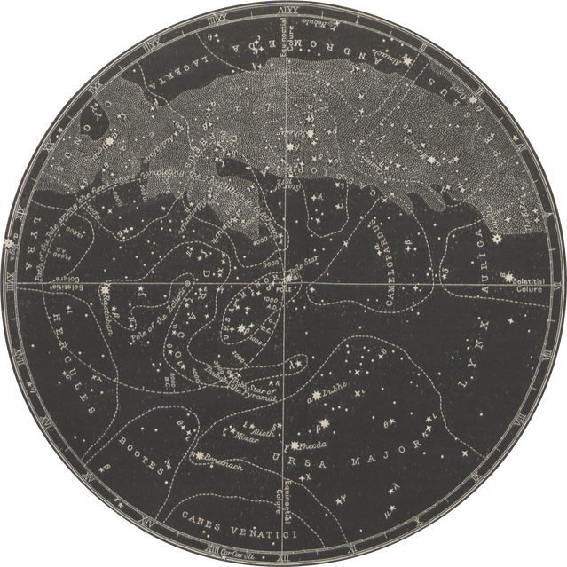



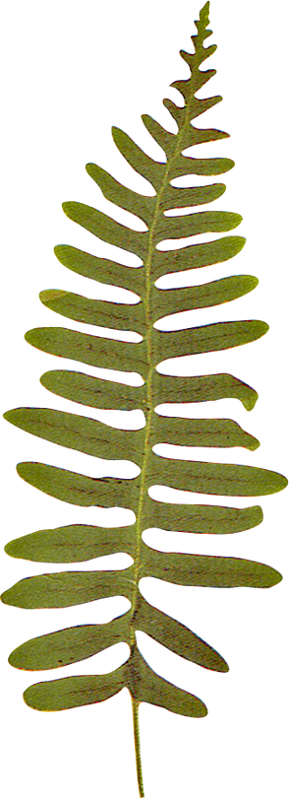
LET'S PLAY
TIC
TAC
TOE

Slide 2
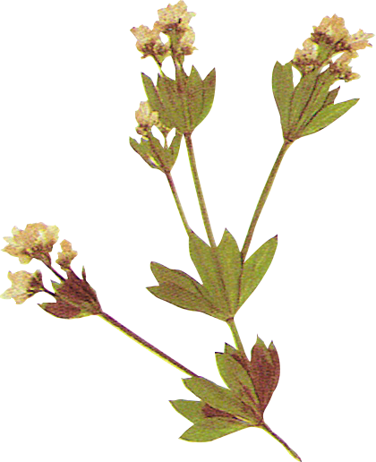
INTRODUCTION:
The program features a text-based interface where players take turns to input their moves, aiming to achieve one of the winning combinations or end the game in a draw. Here's an overview of its functionality:
Key Features:
Game Board Setup:
The game board is represented as a list of 9 elements (board), initially filled with dashes ("-") to indicate empty positions.
2.Players:
There are two players: player1 (marked as "X") and player2 (marked as "O").

Slide 3
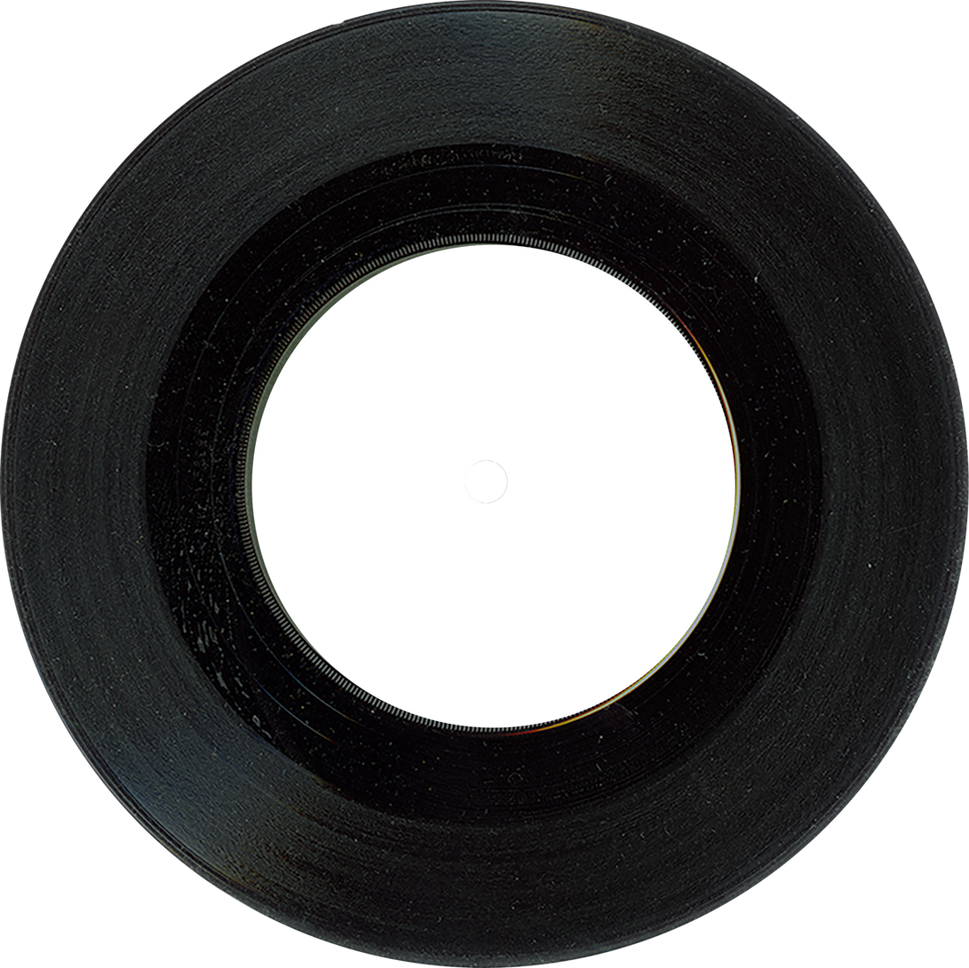
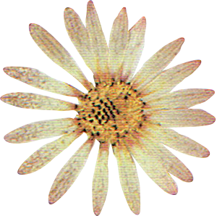
3.Winning Conditions:
The check_conditions(player) function checks if a player has won by achieving any of the predefined winning combinations, such as three marks in a row, column, or diagonal.
4.Game Flow:
The startgame() function controls the game loop:
Players take turns to input their moves, which are validated to ensure the position is between 1 and 9 and not already occupied.
The board updates after each valid move, and the game checks for a winner or a draw.
5.Play Again:
After each game, the program prompts the players to decide whether to play another game or exit.

Slide 4
TECHNOLOGIES USED:
1. Core Python Features:
Lists: Used to represent the Tic-Tac-Toe board. The board is a list of 9 elements that are updated as players make their moves.
Control Flow:
while loops are used to keep the game running and validate user inputs.
Conditional statements (if, else) are used to handle input validation, game logic, and winning conditions.
2.Functions:
Functions like displayboard(), check_conditions(), and startgame() modularize the code for better readability and reusability.
3.Input/Output:
The input() function is used to collect user moves.
The print() function is used to display the board and messages to the players.

Slide 5
SOFTWARE REQUIRED:
1. **Python**: The programming language itself. You can download it from the official Python website or use a distribution like Anaconda.
2. **Jupyter Notebook**: An interactive web application that allows you to create and share documents that contain live code, equations, visualizations, and narrative text. You can install it via pip or as part of the Anaconda distribution.
3. **Anaconda Distribution**: A popular distribution that includes Python, Jupyter Notebook, and many scientific libraries. It simplifies package management and deployment.

Slide 6
PACKAGES AND METHOD USED:
**No External Packages**: The code does not explicitly import any external packages. It relies on built-in Python functionalities, such as lists and input/output operations.
### Methods:
1. **`print()`**: This built-in function is used to output text to the console. In the selected code, it is used to display the current state of the Tic-Tac-Toe board.
2. **`input()`**: This built-in function is used to take user input from the console. It prompts the user to enter their position on the board.
3. **List Indexing**: The code uses list indexing (e.g., `board[3]`, `board[4]`, etc.) to access specific elements of the `board` list, which represents the Tic-Tac-Toe grid.
4. **String Formatting**: The selected code uses string concatenation to format the output for displaying the board. However, it is incomplete and should ideally be wrapped in a `print()` function to display the formatted string correctly.

Slide 7
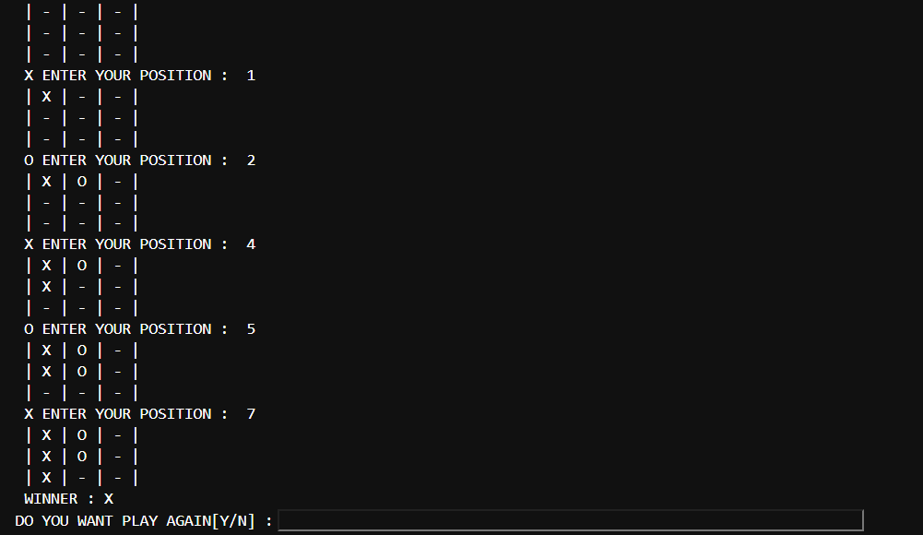
SAMPLE OUTPUT:

Slide 8
CONCLUSION:
Overall, the code provides a straightforward implementation of Tic-Tac-Toe, demonstrating fundamental programming concepts such as loops, conditionals, and user input handling. It serves as a good example for beginners to understand game logic and basic Python programming. However, improvements could be made in terms of code organization, user interface, and error handling for a more robust experience.

Slide 9

Thank you
for playing!

Slide 10

BY:
TEAM IBM FUTURE
SQUAD
SUNIL KUMAR
SAKTHINIRANJAN
SAHAYA DENNIS RUBAN
L SANJAY
PUGAZENTHI

